Slide 1

Simulink Project
$$\text{System} \text{Modelling} \text{For} \text{Magneto} \text{Active} \text{Elastomers}$$
- Parag Pathak

Slide 2
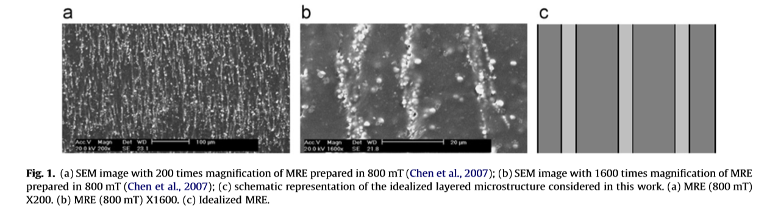
What are MAEs? (Recap)
MAEs consist of magnetic particles, such as micron-size iron particles, dispersed in an elastomeric matrix.
They can undergo large deformations when excited by a magnetic ﬁeld.
Uses include tunable vibration absorbers, damping components , noise barrier system and sensors.
Instabilities can cause failure of these components.

Slide 3
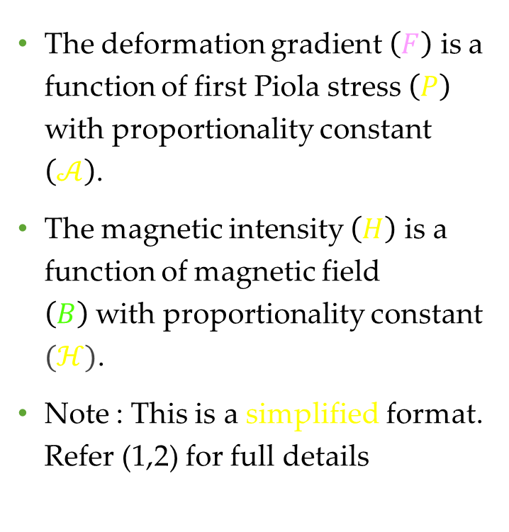


Theoretical model of Magneto elastomers
The deformation gradient $\left(F\right)$ is a function of first Piola stress $\left(P\right)$ with proportionality constant $\left(𝒜\right)$.
The magnetic intensity $\left(H\right)$ is a function of magnetic field $\left(B\right)$with proportionality constant $(ℋ)$.
Note : This is a simplified format. Refer (1,2) for full details
$$P=\overline{G}A\left(\left[λ^{2}−\frac{1}{λ^{2}}\right]−\frac{B^{2}}{λ^{2}\hat{μ}\overline{G}}\right)$$
F
P
P
B
B
H
$$H=ℋB$$

Slide 4
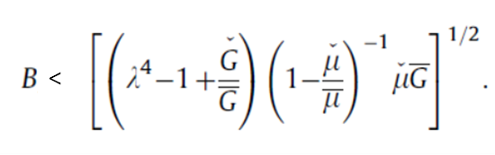
Instability Limit
While the heterogeneity provides access to the tailored and enhanced coupled behaviour, it is also a source for the development of microstructural instabilities.
The instability phenomenon historically has been considered as a failure mode, which is to be predicted and avoided.
The magnetic field values have a certain limit which depends on the deformation of the MAE.

Slide 5


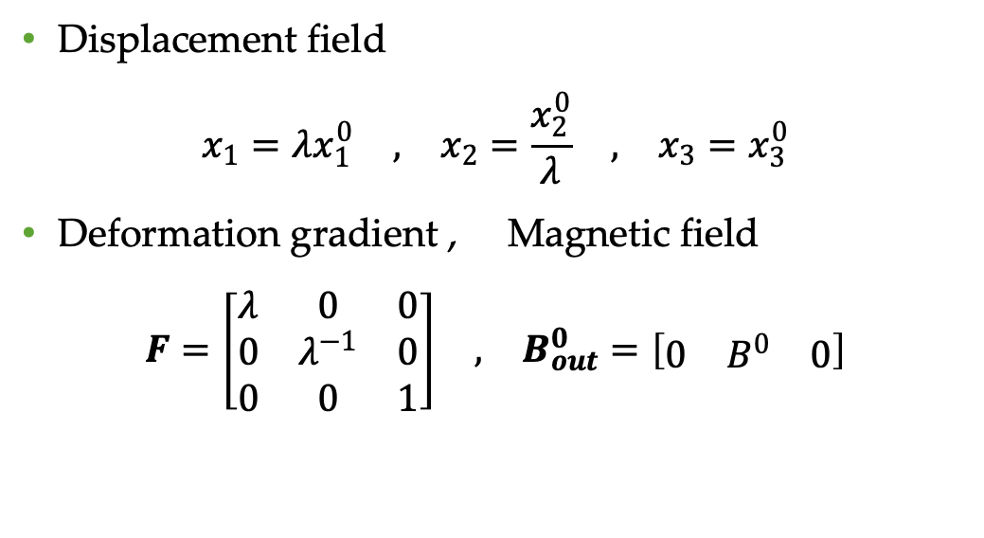


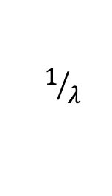
Loading condition
Displacement field
$$\begin{matrix}x_{1}=λx_{1}^{0} & , & x_{2}=\frac{x_{2}^{0}}{λ} & , & x_{3}=x_{3}^{0}\end{matrix}$$
Deformation gradient , Magnetic field
$$\begin{matrix}F=\left[\begin{matrix}λ & 0 & 0 \\ 0 & λ^{−1} & 0 \\ 0 & 0 & 1\end{matrix}\right] & , & B_{out}^{0}=\left[\begin{matrix}0 & B^{0} & 0\end{matrix}\right]\end{matrix}$$
N
$$1/λ$$
MRE Sample
$λ$ v
$$x_{2}^{0}$$
$$B_{out}$$
$$x_{1}^{0}$$
S

Slide 6
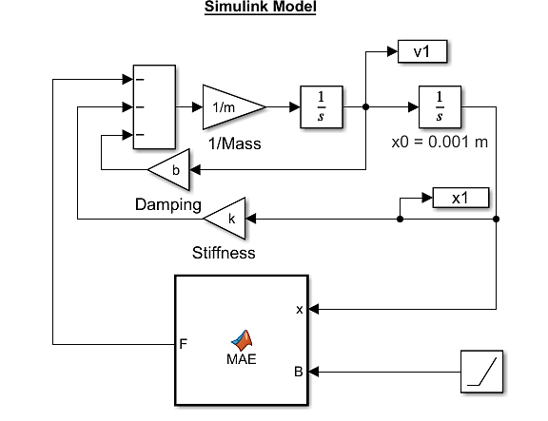
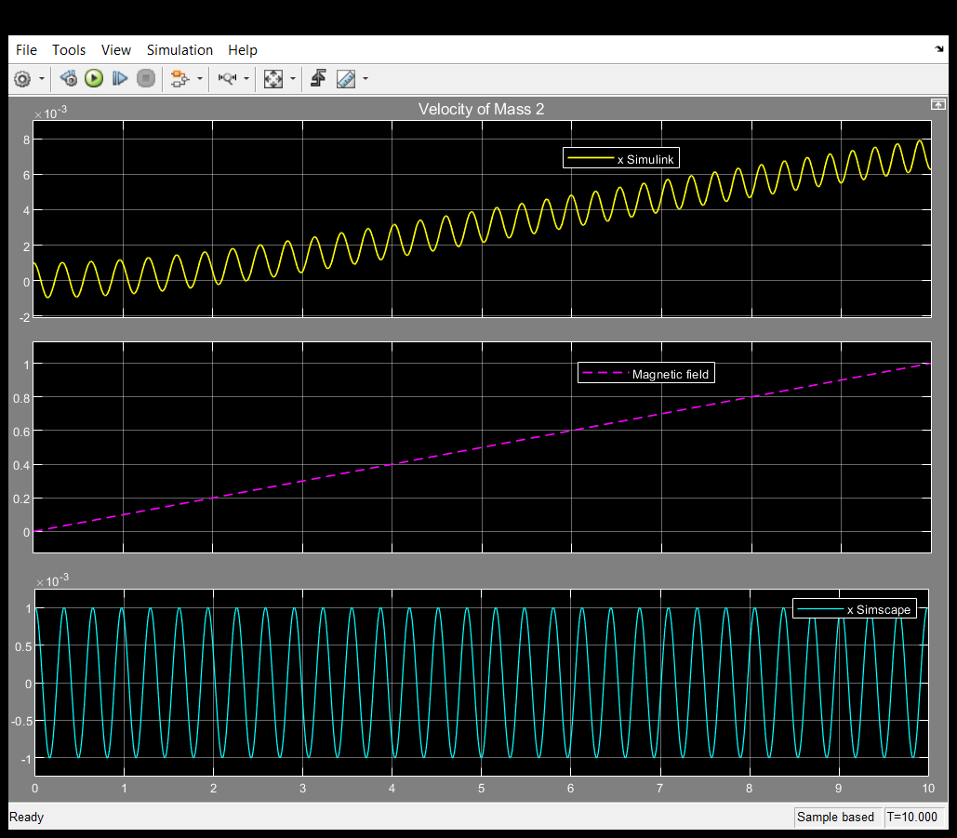
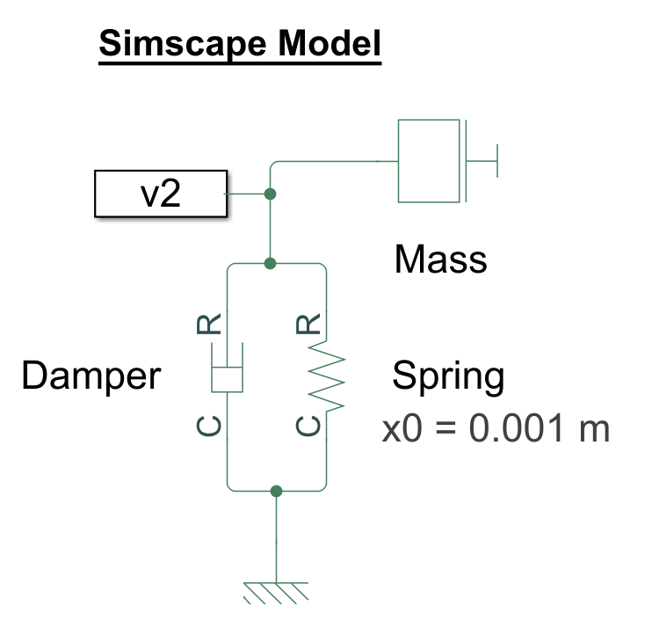
Free vibrations
The behaviour of an MAE was studied under free oscillations. The system was allowed to oscillate freely. This was compared to a simscape model system.

Slide 7
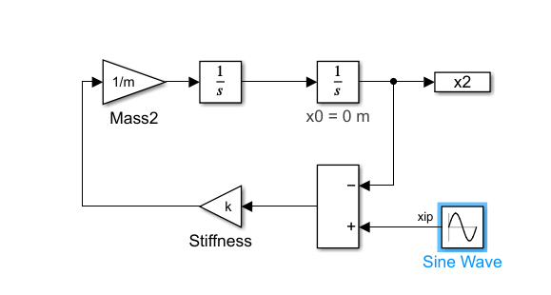
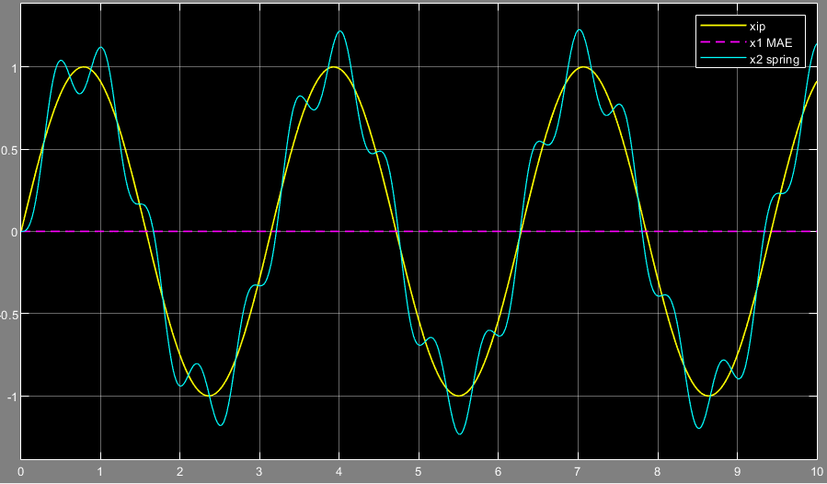
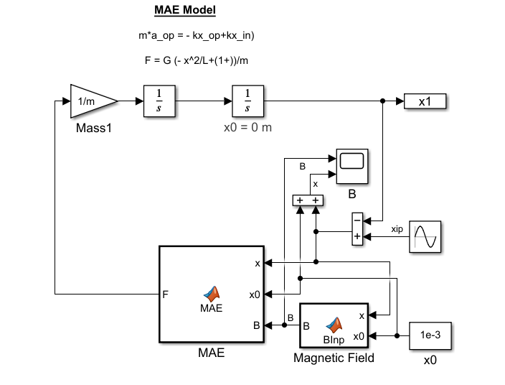
Forced vibrations
Output signal was isolated from the input signals

Slide 8
Conclusions
The MAEs could be tuned to remove noise and isolate the output from the input.
The equilibrium point can be adjusted by applying a magnetic field.
The only limitations are saturation and the stability limits for MAEs which need to be tuned for the desired output range.

Slide 9
References
Pathak, P., Arora, N., & Rudykh, S. (2022). Magnetoelastic instabilities in soft laminates with ferromagnetic hyper elastic phases. International Journal of Mechanical Sciences, 213, 106862.
Bertoldi, K., & Gei, M. (2011). Instabilities in multilayered soft dielectrics. Journal of the Mechanics and Physics of Solids, 59(1), 18-42.
Rudykh, S., & Debotton, G. (2011). Stability of anisotropic electroactive polymers with application to layered media. Zeitschrift für angewandte Mathematik und Physik, 62(6), 1131-1142.
Galipeau, E. (2012). Non-linear homogenization of magnetorheological elastomers at finite strain.
Rudykh, S., & Bertoldi, K. (2013). Stability of anisotropic magnetorheological elastomers in finite deformations: a micromechanical approach. Journal of the Mechanics and Physics of Solids, 61(4), 949-967.
Rudykh, S., Bhattacharya, K., & DeBotton, G. (2014). Multiscale instabilities in soft heterogeneous dielectric elastomers. Proceedings of the Royal Society A: Mathematical, Physical and Engineering Sciences, 470(2162), 20130618.
Goshkoderia, A., & Rudykh, S. (2017). Stability of magneto-active composites with periodic microstructures undergoing finite strains in the presence of a magnetic field. Composites Part B: Engineering, 128, 19-29.

Slide 10
Backup slides

Slide 11


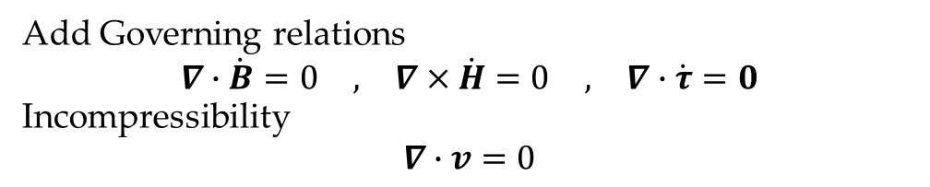

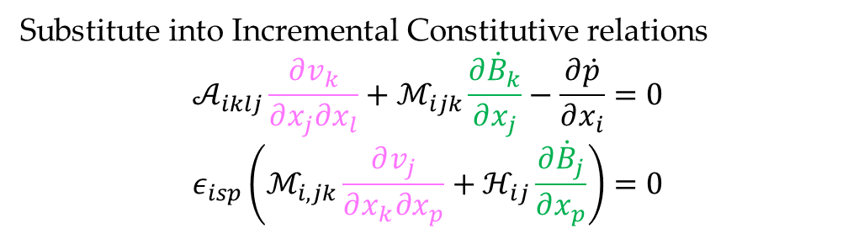






General Solution form
${\dot{u}}_{1}\left(x_{1},x_{2}\right)=v_{1}\left(x_{2}\right)e^{ik_{1}x_{1}}$
${\dot{u}}_{2}\left(x_{1},x_{2}\right)=v_{2}\left(x_{2}\right)e^{ik_{1}x_{1}}$
${\dot{B}}_{1}\left(x_{1},x_{2}\right)=ℬ_{1}\left(x_{2}\right)e^{ik_{1}x_{1}}$
${\dot{B}}_{2}\left(x_{1},x_{2}\right)=ℬ_{2}\left(x_{2}\right)e^{ik_{1}x_{1}}$
$\dot{p}\left(x_{1},x_{2}\right)=q\left(x_{2}\right)e^{ik_{1}x_{1}}$
Fiber phase
$$F$$
$$h$$
$$x_{2}^{0}$$
$$k_{2}$$
$$x_{1}^{0}$$
$$k_{1}$$
$$B_{out}$$
Substitute into Incremental Constitutive relations
$$𝒜_{iklj}\frac{∂v_{k}}{∂x_{j}∂x_{l}}+ℳ_{ijk}\frac{∂{\dot{B}}_{k}}{∂x_{j}}−\frac{∂\dot{p}}{∂x_{i}}=0$$
$$ε_{isp}\left(ℳ_{i,jk}\frac{∂v_{j}}{∂x_{k}∂x_{p}}+ℋ_{ij}\frac{∂{\dot{B}}_{j}}{∂x_{p}}\right)=0$$
Add Governing relations
$$\begin{matrix}∇∙\dot{B}=0 & , & ∇×\dot{H}=0 & , & ∇∙\dot{τ}=0\end{matrix}$$
Incompressibility
$$∇∙v=0$$

Slide 12
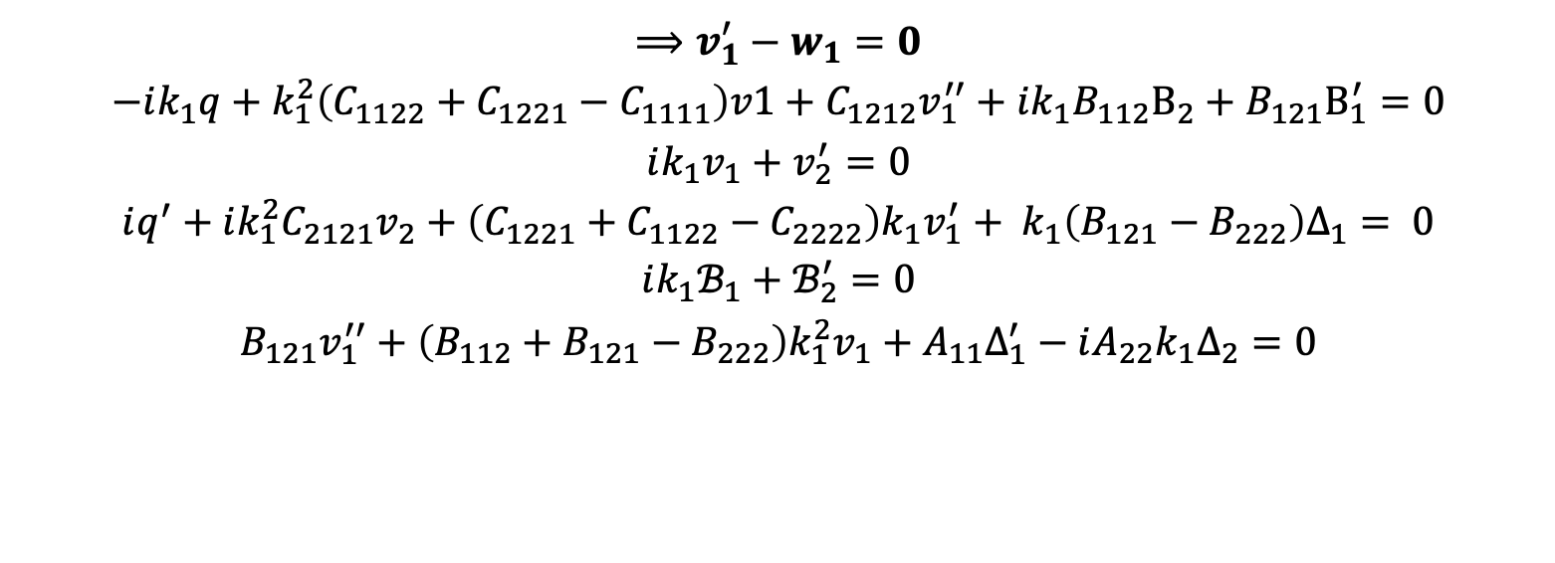
Second order System
$$⟹v_{1}^{′}−w_{1}=0$$
$$−ik_{1}q+k_{1}^{2}\left(C_{1122}+C_{1221}−C_{1111}\right)v1+C_{1212}v_{1}^{′′}+ik_{1}B_{112}B_{2}+{B_{121}B}_{1}^{′}=0$$
$$ik_{1}v_{1}+v_{2}^{′}=0$$
$$iq^{′}+ik_{1}^{2}C_{2121}v_{2}+\left(C_{1221}+C_{1122}−C_{2222}\right)k_{1}v_{1}^{′}+ k_{1}\left(B_{121}−B_{222}\right)Δ_{1}= 0$$
$$ik_{1}ℬ_{1}+ℬ_{2}^{′}=0$$
$$B_{121}v_{1}^{′′}+\left(B_{112}+B_{121}−B_{222}\right)k_{1}^{2}v_{1}+A_{11}Δ_{1}^{′}−iA_{22}k_{1}Δ_{2}=0$$

Slide 13
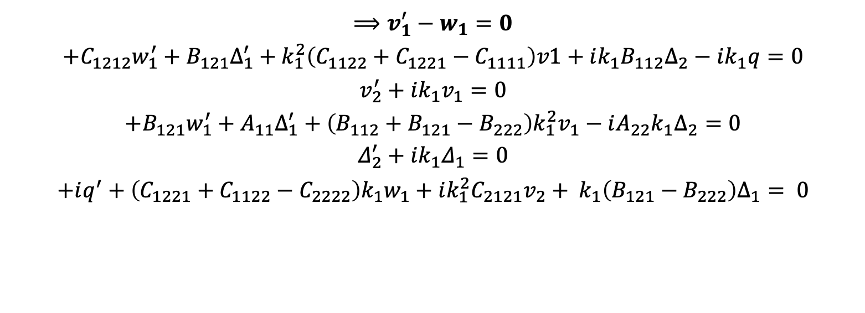
First order system
$$⟹v_{1}^{′}−w_{1}=0$$
$$+C_{1212}w_{1}^{′}+B_{121}Δ_{1}^{′}+k_{1}^{2}\left(C_{1122}+C_{1221}−C_{1111}\right)v1+ik_{1}B_{112}Δ_{2}−ik_{1}q=0$$
$$v_{2}^{′}+ik_{1}v_{1}=0$$
$$+B_{121}w_{1}^{′}+A_{11}Δ_{1}^{′}+\left(B_{112}+B_{121}−B_{222}\right)k_{1}^{2}v_{1}−iA_{22}k_{1}Δ_{2}=0$$
$$Δ_{2}^{′}+ik_{1}Δ_{1}=0$$
$$+iq^{′}+\left(C_{1221}+C_{1122}−C_{2222}\right)k_{1}w_{1}+ik_{1}^{2}C_{2121}v_{2}+ k_{1}\left(B_{121}−B_{222}\right)Δ_{1}= 0$$

Slide 14



General solution for single medium
$$y_{\left(x_{2}\right)}$$
$$y={\left[\begin{matrix}v_{1} & w_{1} & v_{2} & B_{1} & B_{2} & q\end{matrix}\right]}^{T}$$
First Order system
$$Ay^{′}+By=0$$
$$y^{′}=−\left(A^{−1}B\right)y=Vy$$
General Solution
$$y=We^{Zx_{2}}W^{−1}y_{0}$$
$W→$ Eigen vector matrix (V),
$Z→$ Eigenvalue matrix (V)
$$y_{\left(0\right)}$$

Slide 15
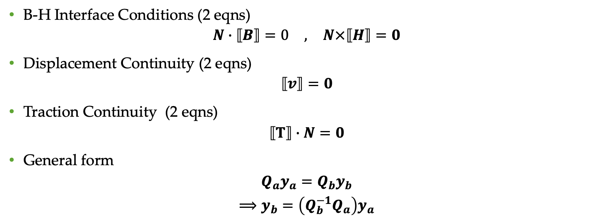
Add Interface conditions for change in medium
B-H Interface Conditions (2 eqns)
$$\begin{matrix}N∙⟦B⟧=0 & , & N×⟦H⟧=0\end{matrix}$$
Displacement Continuity (2 eqns)
$$⟦v⟧=0$$
Traction Continuity (2 eqns)
$$⟦Τ⟧∙N=0$$
General form
$$Q_{a}y_{a}=Q_{b}y_{b}$$
$$⟹y_{b}=\left(Q_{b}^{−1}Q_{a}\right)y_{a}$$
Fiber(b)
Matrix(a)

Slide 16

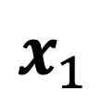



Apply Bloch-Floquet condition to the K-Matrix
$$y_{\left(h\right)}$$
$$e^{ik_{2}h}$$
$$x_{2}$$
$$y_{\left(0\right)}$$
$$x_{1}$$
Bloch-Floquet

Slide 17

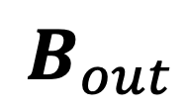
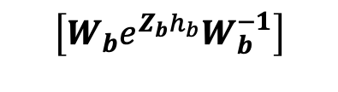




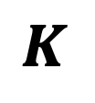
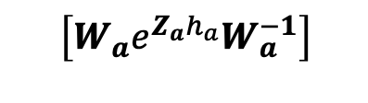

K-Matrix expressions
(a)
(b)
$$y_{\left(h\right)}$$
$$y_{\left(h\right)}$$
$$y_{\left(h\right)}$$
$$\left(Q_{b}^{−1}Q_{a}\right)$$
$$\left[W_{b}e^{Z_{b}h_{b}}W_{b}^{−1}\right]$$
$$K$$
$$\left(Q_{b}^{−1}Q_{a}\right)$$
$$e^{ik_{2}h}$$
$$x_{2}$$
$$\left[W_{a}e^{Z_{a}h_{a}}W_{a}^{−1}\right]$$
$$y_{\left(0\right)}$$
$$y_{\left(0\right)}$$
$$y_{\left(0\right)}$$
$$x_{1}$$
Bloch-Floquet
K-Matrix
$$B_{out}$$

Slide 18

Eigen value constraint
Eigen value problem
$$y_{h}=Ky_{0}=e^{ik_{2}h}y_{0}$$
$$⟹Ky_{0}=ζ_{i}y_{0}$$
Eigen value Constraint
$$ζ_{i}=e^{ik_{2}h}$$
$$⟹\left|ζ_{i}\right|=1$$
Instability condition

Slide 19
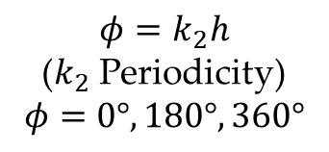

Substitute Eigen value constraint in expression
Eigen value problem
$$y_{h}=Ky_{0}=e^{i\left(φ\right)}y_{0}$$
$$⟹Ky_{0}=ζ_{i}y_{0}$$
Eigen value Constraint
$$f_{B_{m}}\left(λ,k_{1}\right)=\left|K−ζI\right|$$
$$⟹f_{B_{m}}\left(λ_{cr},{k_{1}}_{cr}\right)=0$$
$$∀k_{1},ζ=1,−1$$
$$φ=k_{2}h$$
($k_{2}$ Periodicity)
$$φ=0°,180°,360°$$
New Instability condition

Slide 20
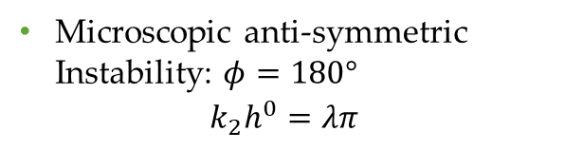
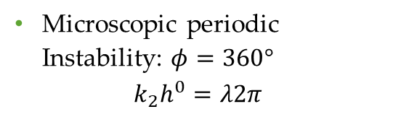
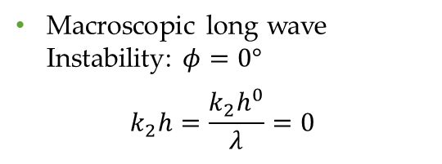
Three cases of instability
Macroscopic long wave Instability: $φ=0°$
$$k_{2}h=\frac{k_{2}h^{0}}{λ}=0$$
Microscopic anti-symmetric Instability: $φ=180°$
$$k_{2}h^{0}=λπ$$
Microscopic periodic Instability: $φ=360°$
$$k_{2}h^{0}=λ2π$$

Slide 21
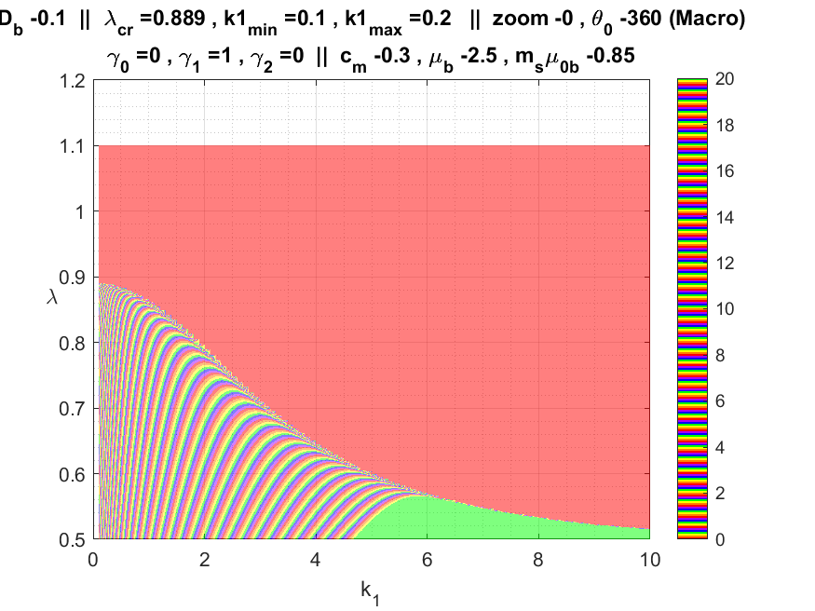

$$f_{B_{m}}\left(λ,k_{1}\right)=\left|K−ζI\right|$$
$$B_{m}=0.1,ζ=1,φ=0° , 360°$$

Slide 22
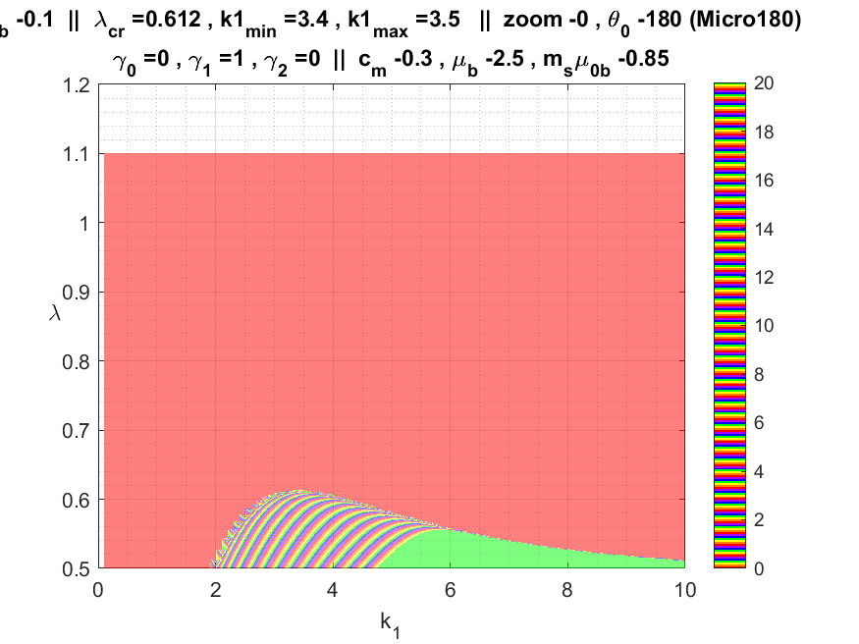

$$f_{B_{m}}\left(λ,k_{1}\right)=\left|K−ζI\right|$$
$$B_{m}=0.1,ζ=−1,φ=180°$$

Slide 23
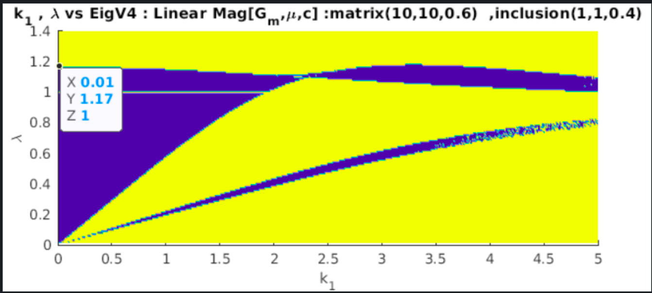

Sample Plot : |Eigen value| vs $λ,k_{1}$
Macroscopic instability
Transition
Microscopic instability
|Eigen value| ~1

Slide 24
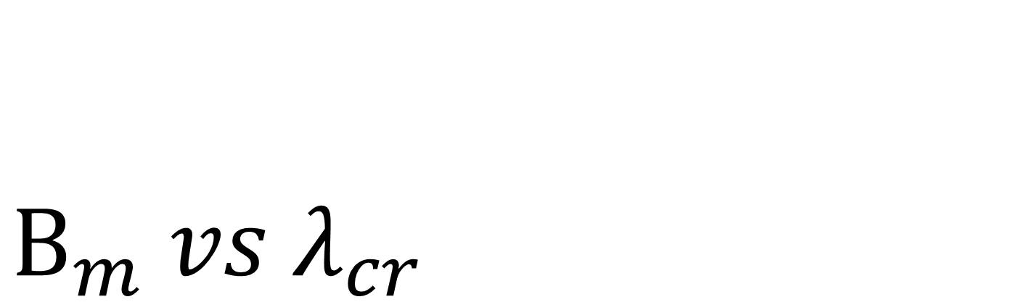
$$B_{m} vs λ_{cr}$$
Transition point from macroscopic to microscopic

Slide 25
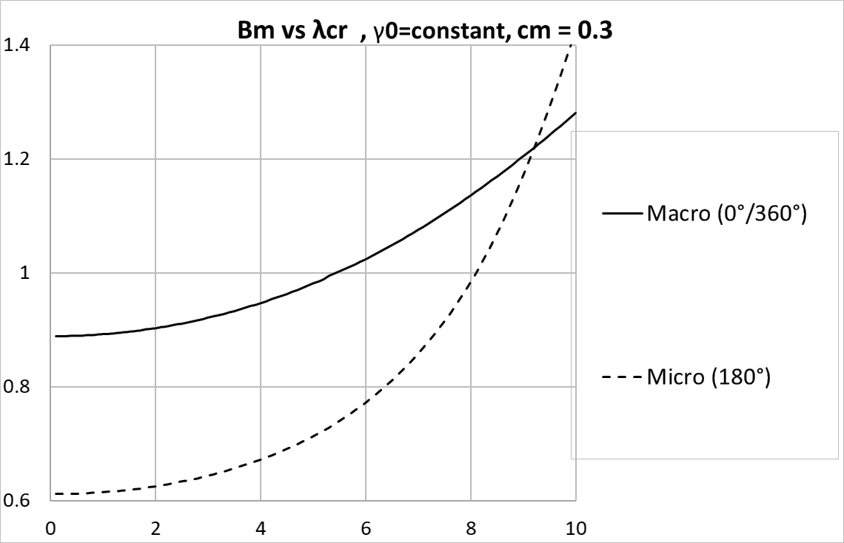


Transition point
$$λ_{cr}$$
$$B_{m}$$
Notes:
Change further curves. Phase = k2 relation

Slide 26
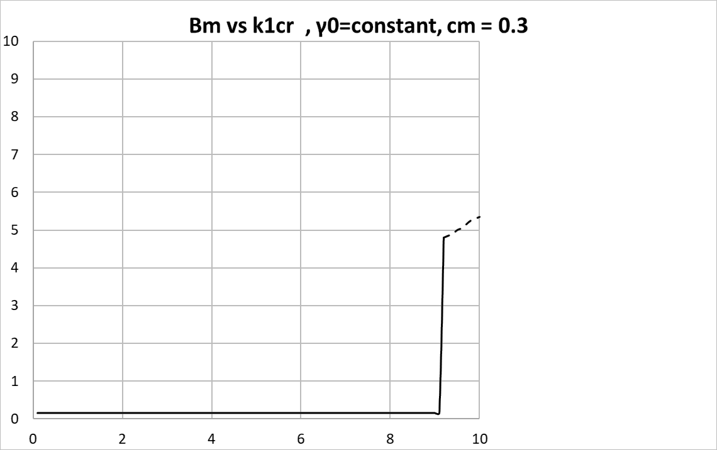


Transition point
$${k_{1}}_{cr}$$
$$B_{m}$$
Notes:
Change further curves. Phase = k2 relation

Slide 27
Transition point Analysis
The transition from macroscopic instability to microscopic depends on where the two curves (0° and 180°) intersect.

Slide 28
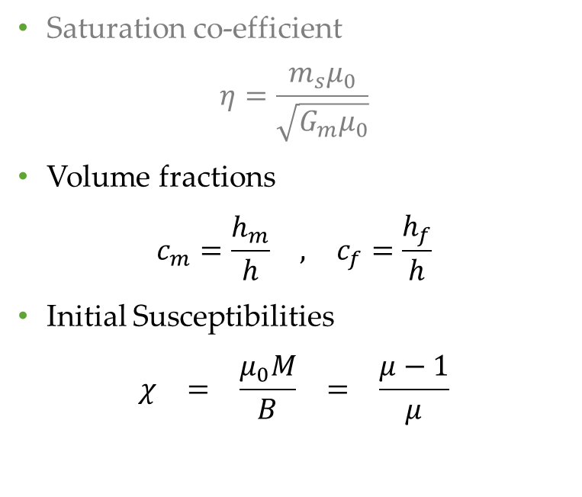
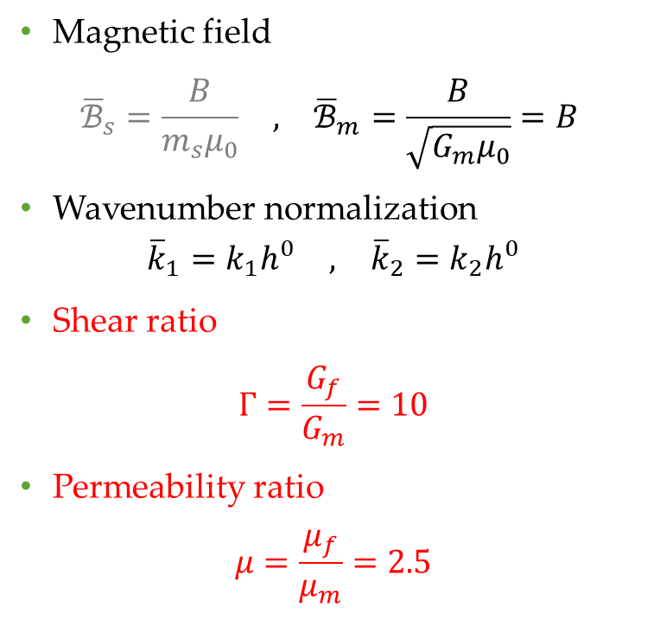
Non-dimentional numbers
$$⟹\begin{matrix}G_{m}=1 & , & μ_{0}=1 & , & μ_{m}=1 & , & h^{0}=1\end{matrix}$$
Magnetic field
$$\begin{matrix}{\overline{ℬ}}_{s}=\frac{B}{m_{s}μ_{0}} & , & {\overline{ℬ}}_{m}=\frac{B}{\sqrt{G_{m}μ_{0}}}=B\end{matrix}$$
Wavenumber normalization
$$\begin{matrix}{\overline{k}}_{1}=k_{1}h^{0} & , & {\overline{k}}_{2}=k_{2}h^{0}\end{matrix}$$
Shear ratio
$$Γ=\frac{G_{f}}{G_{m}}=10$$
Permeability ratio
$$μ=\frac{μ_{f}}{μ_{m}}=2.5$$
Saturation co-efficient
$$η=\frac{m_{s}μ_{0}}{\sqrt{G_{m}μ_{0}}}$$
Volume fractions
$$\begin{matrix}c_{m}=\frac{h_{m}}{h} & , & c_{f}=\frac{h_{f}}{h}\end{matrix}$$
Initial Susceptibilities
$$\begin{matrix}χ & = & \frac{μ_{0}M}{B} & = & \frac{μ−1}{μ}\end{matrix}$$

Slide 29
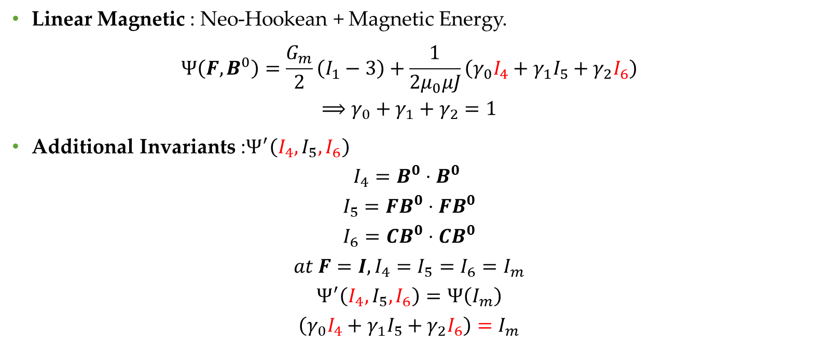
Energy model
Linear Magnetic : Neo-Hookean + Magnetic Energy.
$$Ψ\left(F,B^{0}\right)=\frac{G_{m}}{2}\left(I_{1}−3\right)+\frac{1}{2μ_{0}μJ}\left(γ_{0}I_{4}+γ_{1}I_{5}+γ_{2}I_{6}\right)$$
$$⟹γ_{0}+γ_{1}+γ_{2}=1$$
Additional Invariants :$Ψ^{′}\left(I_{4},I_{5},I_{6}\right)$
$$I_{4}=B^{0}⋅B^{0}$$
$$I_{5}={FB}^{0}⋅{FB}^{0}$$
$$I_{6}={CB}^{0}⋅{CB}^{0}$$
$$at F=I,I_{4}=I_{5}=I_{6}=I_{m}$$
$$Ψ^{′}\left(I_{4},I_{5},I_{6}\right)=Ψ\left(I_{m}\right)$$
$$\left(γ_{0}I_{4}+γ_{1}I_{5}+γ_{2}I_{6}\right)=I_{m}$$

Slide 30
Eigen value expressions

Slide 31
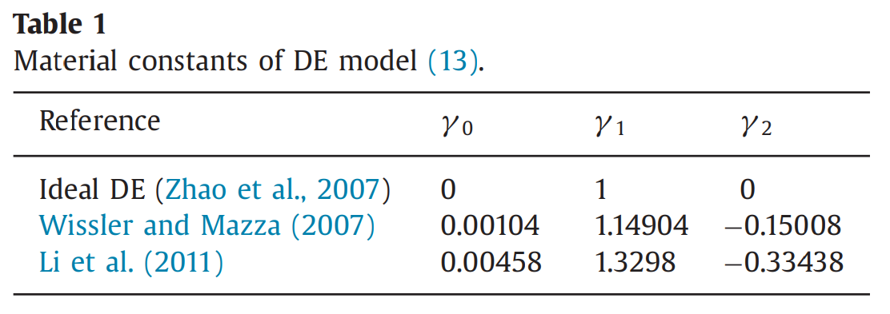

Sample $Γ$ Coefficients (Dielectric case)

Slide 32







Fiber
(Magnetic)
Energy Eqn
$$G_{a}, μ_{a}$$
$$B,λ$$
$$G_{b},μ_{b}$$
$$𝒜$$
$$ℳ$$
$ℋ$
$$c_{m}$$
$${∀k}_{1}$$
$$K$$
$$λ_{cr} vs B$$
$$𝒜$$
$$ℳ$$
$ℋ$
Stability
Material Control Parameters
Matrix
(neo-Hookean)

Slide 33

Fiber
(Magnetic)
Energy Eqn
$$G_{a}, μ_{a}$$
$$B,λ$$
$$G_{b},μ_{b}$$
$$γ_{0}, γ_{1},γ_{2}$$
$$𝒜$$
$$ℳ$$
$ℋ$
$$c_{m}$$
$${∀k}_{1}$$
$$K$$
$$λ_{cr} vs B$$
$$𝒜$$
$$ℳ$$
$ℋ$
Stability
Material Control Parameters
Matrix
(neo-Hookean)

Slide 34




Linear Model for Fiber Phase:
$$\begin{matrix}𝒜_{ijkl}=J^{−1}F_{jα}F_{lβ}\left(\frac{∂^{2}Ψ\left(F,B^{0}\right)}{∂F_{ij}∂F_{kl}}\right) \\ ℳ_{ijk}=F_{jα}F_{kβ}^{−1}\left(\frac{∂^{2}Ψ\left(F,B^{0}\right)}{∂F_{ij}∂B_{k}^{0}}\right) \\ ℋ_{ij}=JF_{iα}^{−1}F_{jβ}^{−1}\left(\frac{δ^{2}Ψ\left(F,B^{0}\right)}{∂B_{i}^{0}∂B_{k}^{0}}\right)\end{matrix}$$
$$ℋ_{11}=ℋ_{22}=\frac{1}{μμ_{0}}$$
$$ℳ_{121}\left(B\right)=ℳ_{211}\left(B\right)=\frac{1}{μμ_{0}}B$$
$$ℳ_{222}\left(B\right)=\frac{2}{μμ_{0}}B$$
$$𝒜_{1111}\left(λ\right)=𝒜_{2121}\left(λ\right)=G_{i}λ^{2}$$
$$𝒜_{1212}\left(λ,B\right)=𝒜_{2222}\left(λ,B\right)=\frac{G_{i}}{λ^{2}}+\frac{B^{2}}{μμ_{0}}$$

Slide 35




Linear Model for Fiber Phase: $Γ$ Coefficients
$$𝒜_{1111}\left(λ\right)=G_{i}λ^{2}$$
$${𝒜_{1221}\left(λ\right)=𝒜}_{2112}\left(λ\right)=\frac{B^{2}}{μμ_{0}}\left(γ_{2}λ^{2}\right)$$
$$𝒜_{2121}\left(λ\right)=G_{i}λ^{2}+\frac{B^{2}}{μμ_{0}}\left(γ_{2}λ^{2}\right)$$
$$𝒜_{1212}\left(λ,B\right)=\frac{G_{i}}{λ^{2}}+\frac{B^{2}}{μμ_{0}}\left(γ_{1}+γ_{2}\left(\frac{2}{λ^{2}}+λ^{2}\right)\right)$$
$$𝒜_{2222}\left(λ,B\right)=\frac{G_{i}}{λ^{2}}+\frac{B^{2}}{μμ_{0}}\left(γ_{1}+\frac{6γ_{2}}{λ^{2}}\right)$$
$$ℋ_{11}=ℋ_{22}=\frac{1}{μμ_{0}}\left(\frac{γ_{0}}{λ^{2}}+γ_{1}+γ_{2}λ^{2}\right)$$
$$ℳ_{121}\left(B\right)=ℳ_{211}\left(B\right)=\frac{1}{μμ_{0}}B\left(\frac{γ_{0}}{λ^{2}}+γ_{1}+γ_{2}λ^{2}\right)$$
$$ℳ_{222}\left(B\right)=\frac{2}{μμ_{0}}B\left(γ_{1}+2\frac{γ_{2}}{λ^{2}}\right)$$

Slide 36

B-H Relationships
Stress-Magnetization-Energy relationship
$$P=\frac{∂Ψ\left(F,B^{0}\right)}{∂F}−pF^{−T}$$
$$H^{0}=\frac{∂Ψ\left(F,B^{0}\right)}{∂B^{0}}$$

Slide 37

B-H Relationships
 | Linear Magnetic model | With Γ Coefficients
Magnetization | $$μ_{0}M=Bχ=B\frac{\left(μ−1\right)}{μ}$$ | $$μ_{0}M=Bχ′=B\frac{\left(μ′−1\right)}{μ′}$$
Magnetic intensity | $$μ_{0}H=\frac{B}{μ}=B\left(1−χ\right)$$ | $$μ_{0}H=\frac{B}{μ′}=\frac{B}{μ}\left(\frac{γ_{2}}{λ^{2}}+γ_{1}+γ_{0}λ^{2}\right)$$

Slide 38

Conclusions
Instability can be of three types long wave microscopic , microscopic periodic and anti symmetric periodic. Transitions usually happen from long wave to anti-symmetric microscopic.
Higher $γ_{2}$ values lowers the $λ_{cr}$. Higher $γ_{0}$ values lowers the $λ_{cr}$ for low magnetic fields, but this trend reverses for higher magnetic fields.
Transitions happen at lower magnetic fields for higher $γ_{0}$ values and lower volume fraction of matrix $c_{m}$.

